Slide 1
Module 18: Protection
Goals of Protection
Domain of Protection
Access Matrix
Implementation of Access Matrix
Revocation of Access Rights
Capability-Based Systems
Language-Based Protection

Slide 2
Protection
Operating system consists of a collection of objects, hardware or software
Each object has a unique name and can be accessed through a well-defined set of operations.
Protection problem - ensure that each object is accessed correctly and only by those processes that are allowed to do so.

Slide 3
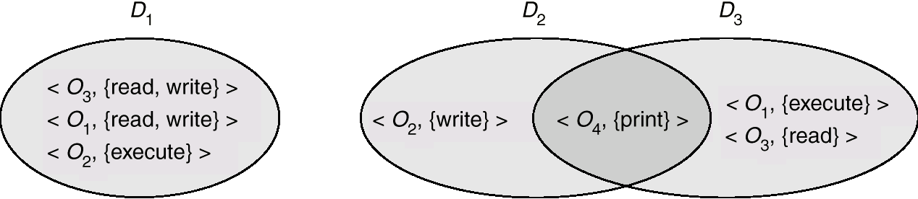
Domain Structure
Access-right = <object-name, rights-set>
where rights-set is a subset of all valid operations that can be performed on the object.
Domain = set of access-rights

Slide 4
Domain Implementation (UNIX)
System consists of 2 domains:
  User
  Supervisor
UNIX
  Domain = user-id
  Domain switch accomplished via file system.
    Each file has associated with it a domain bit (setuid bit).
    When file is executed and setuid = on, then user-id is set to owner of the file being executed. When execution completes user-id is reset.

Slide 5
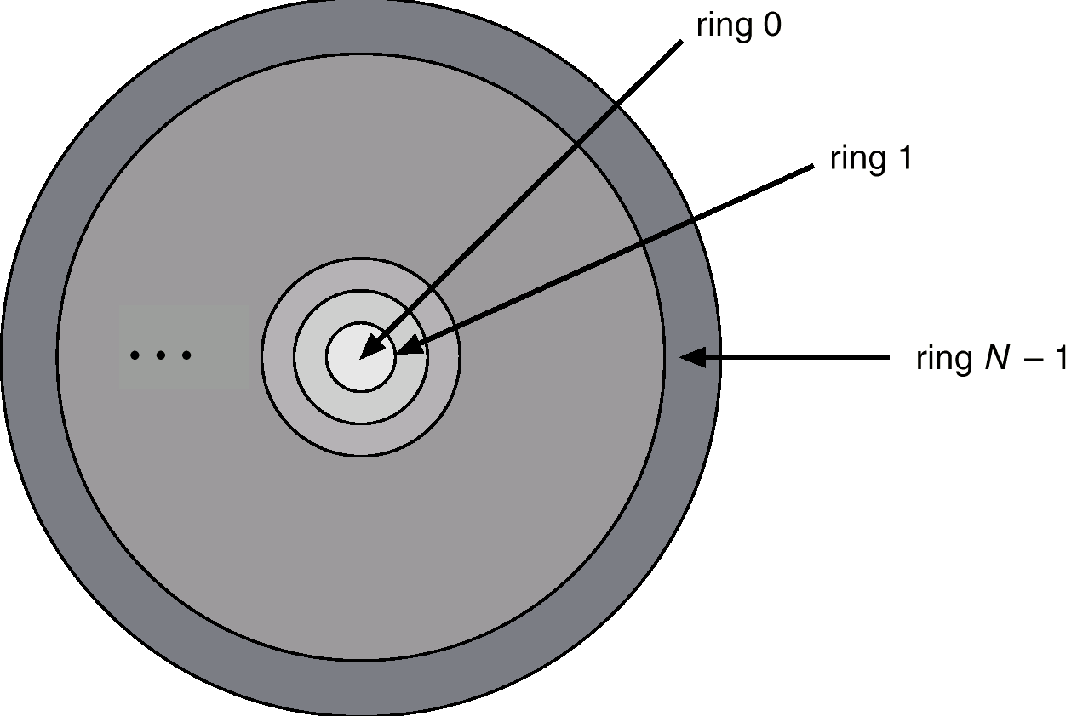
Domain Implementation (Multics)
Let D_{i} and D_{j} be any two domain rings.
If j < I ⇒ D_{i} ⊆ D_{j}
Multics Rings

Slide 6
Access Matrix
View protection as a matrix (access matrix)
Rows represent domains
Columns represent objects
Access(i, j) is the set of operations that a process executing in Domain_{i} can invoke on Object_{j}

Slide 7
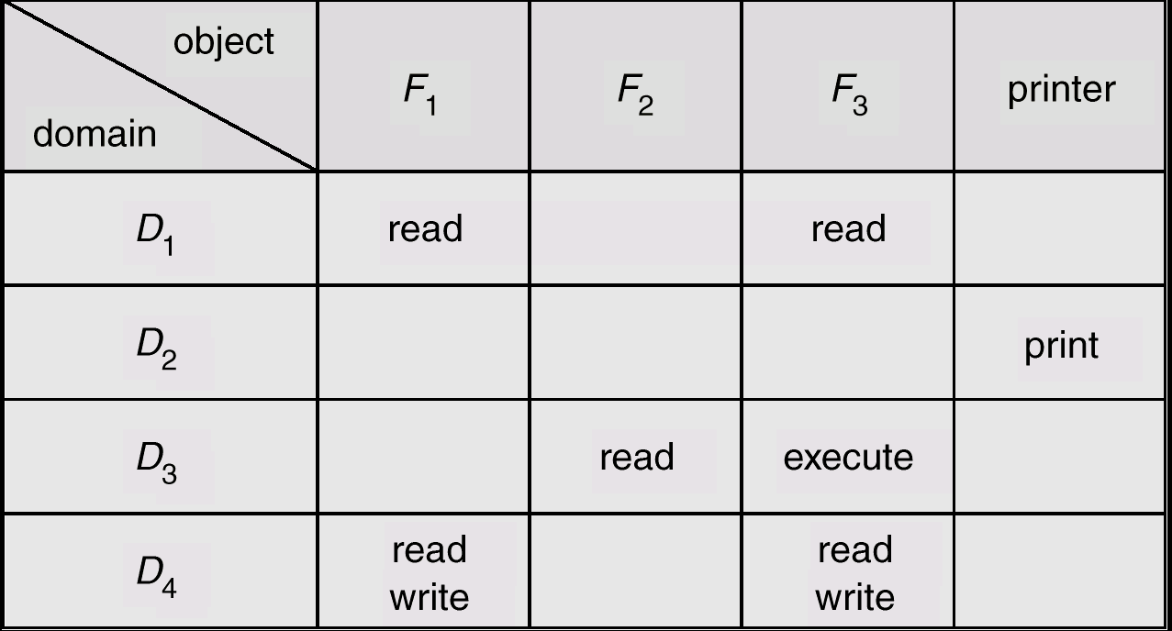
Access Matrix
Figure A

Slide 8
Use of Access Matrix
If a process in Domain D_{i} tries to do “op” on object O_{j}, then “op” must be in the access matrix.
Can be expanded to dynamic protection.
  Operations to add, delete access rights.
  Special access rights:
    owner of O_{i}
    copy op from O_{i} to O_{j}
    control – D_{i} can modify D_{j} access rights
    transfer – switch from domain D_{i} to D_{j}

Slide 9
Use of Access Matrix (Cont.)
Access matrix design separates mechanism from policy.
  Mechanism
    Operating system provides access-matrix + rules.
    If ensures that the matrix is only manipulated by authorized agents and that rules are strictly enforced.
  Policy
    User dictates policy.
    Who can access what object and in what mode.

Slide 10
Implementation of Access Matrix
Each column = Access-control list for one object
Defines who can perform what operation.
Domain 1 = Read, Write
Domain 2 = Read
Domain 3 = Read

Each Row = Capability List (like a key)
Fore each domain, what operations allowed on what objects.
      Object 1 – Read
      Object 4 – Read, Write, Execute
      Object 5 – Read, Write, Delete, Copy

Slide 11
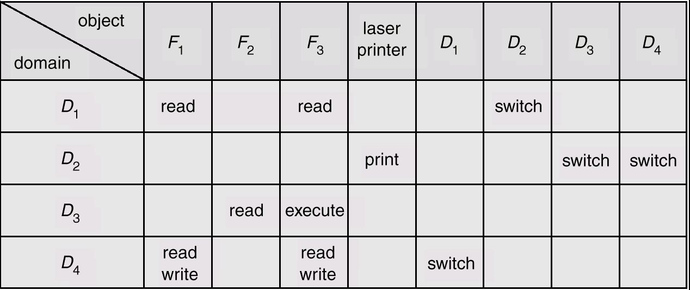
Access Matrix of Figure A With Domains as Objects
Figure B

Slide 12
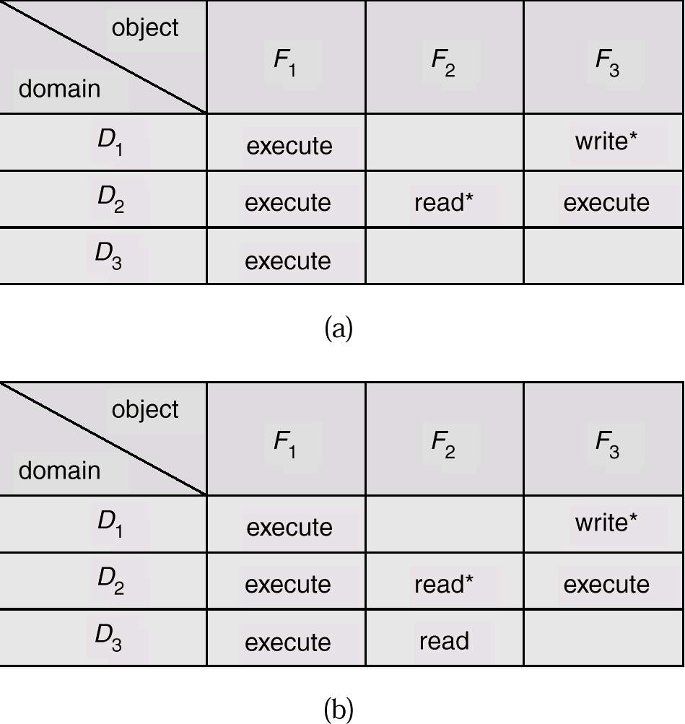
Access Matrix with Copy Rights

Slide 13
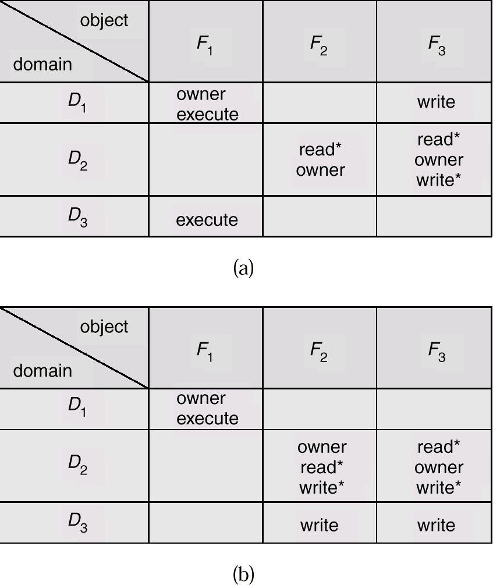
Access Matrix With Owner Rights

Slide 14
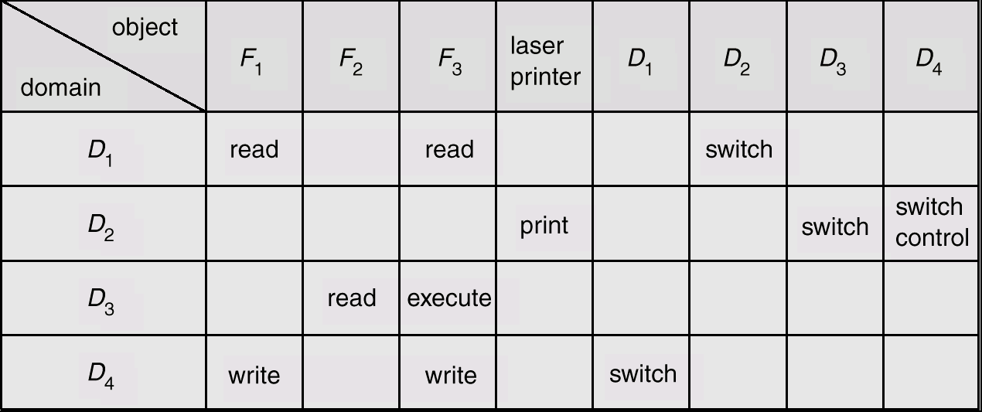
Modified Access Matrix of Figure B

Slide 15
Revocation of Access Rights
Access List – Delete access rights from access list.
  Simple
  Immediate
Capability List – Scheme required to locate capability in the system before capability can be revoked.
  Reacquisition
  Back-pointers
  Indirection
  Keys

Slide 16
Capability-Based Systems
Hydra
  Fixed set of access rights known to and interpreted by the system.
  Interpretation of user-defined rights performed solely by user's program; system provides access protection for use of these rights.
Cambridge CAP System
  Data capability - provides standard read, write, execute of individual storage segments associated with object.
  Software capability -interpretation left to the subsystem, through its protected procedures.

Slide 17
Language-Based Protection
Specification of protection in a programming language allows the high-level description of policies for the allocation and use of resources.
Language implementation can provide software for protection enforcement when automatic hardware-supported checking is unavailable.
Interpret protection specifications to generate calls on whatever protection system is provided by the hardware and the operating system.

Slide 18
Protection in Java 2
Protection is handled by the Java Virtual Machine (JVM)
A class is assigned a protection domain when it is loaded by the JVM.
The protection domain indicates what operations the class can (and cannot) perform.
If a library method is invoked that performs a privileged operation, the stack is inspected to ensure the operation can be performed by the library.

Slide 19
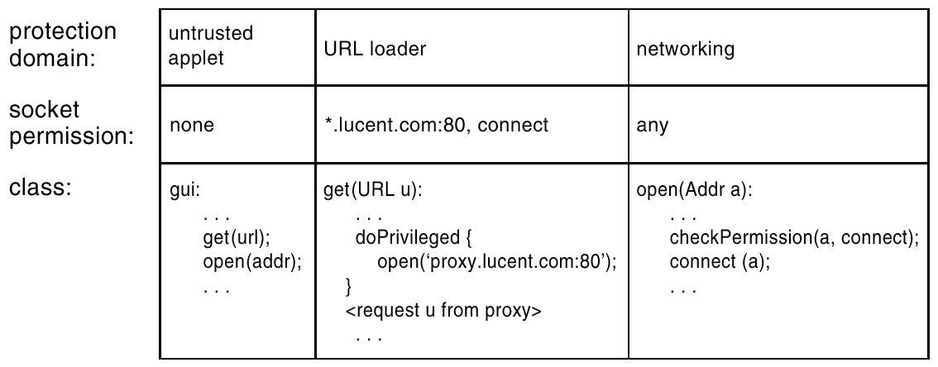
Stack Inspection

